Slide 1
PHANTOM
Phantom slide
Notes:
As Chris and Josh have repeatedly mentioned – classical MD works on solving the Newton’s equations of motions. You get the force by differentiating an energy function. The most accurate way of solving this energy function is through quantum chemistry but it’s not feasible to get enough data. So we simply the equations that we have to solve by describing them as simple functions. And we decompose the energy into different components – more on this later. And each component of the energy is described by a different, but simple function. Of course this isn’t the only way to decompose energy, you can have more complicated terms. By playing around with these functions and energy components you get different forcefields – when you read papers keep an eye out for these names.
Let’s look at the inner workings of these forcefields by understanding how the forcefield that you are using in GROMACS works.

Slide 2

And the experimentalists always ask you
“How do you know it’s right?
How do you know it’s right?
How do you know it’s right? …”
Kamehameha!
FORCEFIELDS
Feb 3 3017
Notes:
On the first day of class Jim mentioned that experimentalist will always want to know how you have validated your model and the accuracy of its predictions. There are several factors that govern the accuracy of your simulations like length of simulations, convergence of your simulation, but I would argue that the model or forcefield that you use is the most important. So it’s super important to acquaint yourself with what goes into your forcefield to truly justify why you use one model versus the other to yourself and the experimentalist.
Ofcourse, another way out of justifying your model is annihilating the person with you favorite Dragon Ball Z attack but let’s try to keep this civil

Slide 3
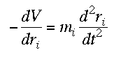
Introduction
Classical MD forces are derived from energy
Quantum chemistry calculations not feasible
Simple functional form describing energy components (with set parameters)
A common decomposition of energy:
An alphabet soup of forcefields
Common terms in PRG
GROMACS Simulation Engine- GROningen MAchine for Chemical Simulations
AMBER FF- Assisted Model Building with Energy Refinement (Kollman)
CHARMM FF - Chemistry at Harvard Macromolecular Mechanics (Karplus)
(AMBER is also the name of a simulation engine)
E_{bonded} = E_{bond} + E_{angle} + E_{dihedral}
E_{nonbonded} = E_{electrostatic} + E_{LJ}
AMBER, CHARMM, OPLS, PFF, XPOL, MARTINI,
INTERFACE, GROMOS, GAFF, ReaxFF
Reference > https://dasher.wustl.edu/ponder/papers/advprotchem-66-27-03.pdf
Notes:
As Chris and Josh have repeatedly mentioned – classical MD works on solving the Newton’s equations of motions. You get the force by differentiating an energy function. The most accurate way of solving this energy function is through quantum chemistry but it’s not feasible to get enough data. So we simply the equations that we have to solve by describing them as simple functions. And we decompose the energy into different components – more on this later. And each component of the energy is described by a different, but simple function. Of course this isn’t the only way to decompose energy, you can have more complicated terms. By playing around with these functions and energy components you get different forcefields – when you read papers keep an eye out for these names.
Let’s look at the inner workings of these forcefields by understanding how the forcefield that you are using in GROMACS works.

Slide 4
Components of classical MD forcefields
Atom Type Definitions
Multiple types for the same atom
Differs in charge, attraction and repulsion
Carbon Name | Carbon Type
C | sp2 C in C=O
C1 | Sp1 C
C2 | sp2 C, aliphatic
C3 | sp3 C
Ca | sp2 C, aromatic
Reference > http://edoc.hu-berlin.de/dissertationen/physik/severin-nikolai/HTML/severin-ch2.html
Notes:
Let’s look at bonded interactions first. These

Slide 5
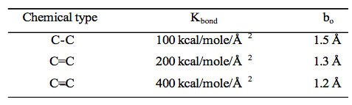
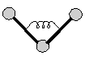

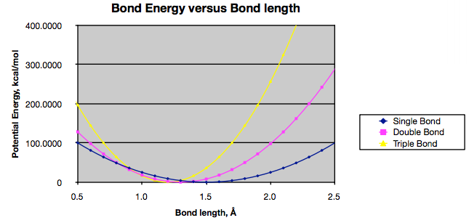
Components of classical MD forcefields
Bonded interactions
E_{bond} + E_{angle}
K_{b} (b – b₀⁾² K_{θ} (θ – θ₀)²
b/θ – Instantaneous value of variable
b0/θ0 – Parameter1 – Equilibrium value
Kb/ Kθ – Parameter 2 – Force constant
Reference > http://edoc.hu-berlin.de/dissertationen/physik/severin-nikolai/HTML/severin-ch2.html
Notes:
Let’s look at bonded interactions first. These

Slide 6
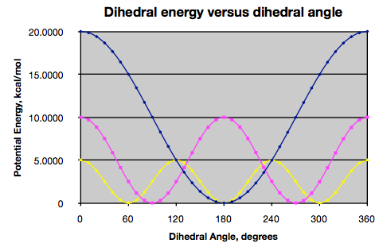
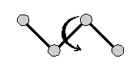
Components of classical MD forcefields
Bonded interactions – maintain structural stability
E_{bond} + E_{angle} + E_{dihedral}
K_{θ} [1 + cos(ɸ – ɸ₀)]
Sinusoidal
Reference > http://edoc.hu-berlin.de/dissertationen/physik/severin-nikolai/HTML/severin-ch2.html
Notes:
Let’s look at bonded interactions first. These

Slide 7
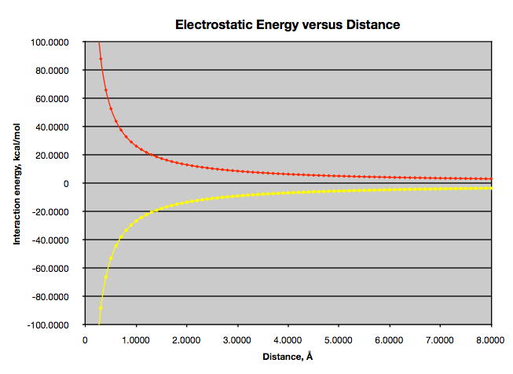
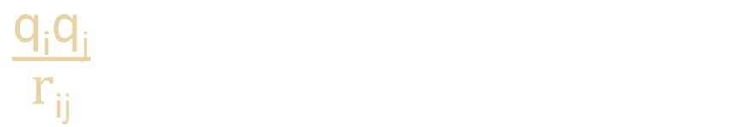
Components of classical MD forcefields
Non-bonded interactions
E_{electrostatic} + E_{LJ}
$\frac{\text{q}\text{i}\text{q}\text{j}}{\text{r}\text{ij}}$
Coulomb’s Law
Reference > http://edoc.hu-berlin.de/dissertationen/physik/severin-nikolai/HTML/severin-ch2.html
Notes:
The r⁻¹² term, which is the repulsive term, describes Pauli repulsion at short ranges due to overlapping electron orbitals and the r⁻⁶ term, which is the attractive long-range term, describes attraction at long ranges (van der Waals force, or dispersion force). Whereas the functional form of the attractive term has a clear physical justification, the repulsive term has no theoretical justification. It is used because it approximates the Pauli repulsion well, and is more convenient due to the relative computing efficiency of calculating r¹² as the square of r⁶.

Slide 8
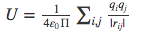
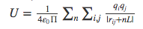
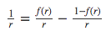
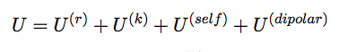
Side Note: Particle Mesh Ewald Summation
Cutoffs introduce artifacts
Direct sum method
Problems with convergence
Infinite sum
Ewald sum method
Ewald splitting parameter f(r)
U(r) – real space
U(k) – Fourier transform or Fast Fourier transform (on a grid)
Last 2 terms are corrections
Time – N^2 for Ewald, NlogN for PME
Ewald energy form
Reference > http://aip.scitation.org/doi/pdf/10.1063/1.464397
Notes:
The r⁻¹² term, which is the repulsive term, describes Pauli repulsion at short ranges due to overlapping electron orbitals and the r⁻⁶ term, which is the attractive long-range term, describes attraction at long ranges (van der Waals force, or dispersion force). Whereas the functional form of the attractive term has a clear physical justification, the repulsive term has no theoretical justification. It is used because it approximates the Pauli repulsion well, and is more convenient due to the relative computing efficiency of calculating r¹² as the square of r⁶.

Slide 9

Components of classical MD forcefields
Non-bonded interactions
E_{electrostatic} + E_{LJ}
$\frac{\text{q}\text{i}\text{q}\text{j}}{\text{r}\text{12}\text{ij}}$ ⁻ $\frac{\text{q}\text{i}\text{q}\text{j}}{\text{r}\text{6}\text{ij}}$
Repulsive – faster decay
Attractive– slow decay
Reference > http://edoc.hu-berlin.de/dissertationen/physik/severin-nikolai/HTML/severin-ch2.html
Notes:
The r⁻¹² term, which is the repulsive term, describes Pauli repulsion at short ranges due to overlapping electron orbitals and the r⁻⁶ term, which is the attractive long-range term, describes attraction at long ranges (van der Waals force, or dispersion force). Whereas the functional form of the attractive term has a clear physical justification, the repulsive term has no theoretical justification. It is used because it approximates the Pauli repulsion well, and is more convenient due to the relative computing efficiency of calculating r¹² as the square of r⁶.

Slide 10
Generating parameters for forcefields
Bonds
Length – X-ray, NMR, Higher levels of theory (ab initio)
Force constant – Regression of theoretical data
Angles
Cambridge structure database, ab initio, heuristics
Torsion
Angle scan with ab initio
Charges
CHARMM (Mulliken)
AMBER (ESP/RESP)
Reference > http://ambermd.org/antechamber/gaff.html

Slide 11
Limitations of classical forcefields
No chemistry – bond dissociation/formation (ReaxFF)
Fixed charges – no polarization (X-pol), electron/proton transition/transport
Parameterized for limited conditions – vacuum, 300 K, RNA/polymers/inorganics
Every new system needs a new model
Too much detail – not coarse enough (MARTINI)
Reference > http://ambermd.org/antechamber/gaff.html

Slide 12
Homework
Investigating a forcefield
Download the zip file from Github, extract files
Reference slides, GROMACS manual and Prof. Google to find:
The purpose of each file (aminoacids.rtp , forcefield.itp, …)
Content of each file, and its format ( File X has a list of atom names, atomic weights …)
Units used in each file ( kcal/mol or kJ/mol, nm or Angstrom, … )

